Slide 1
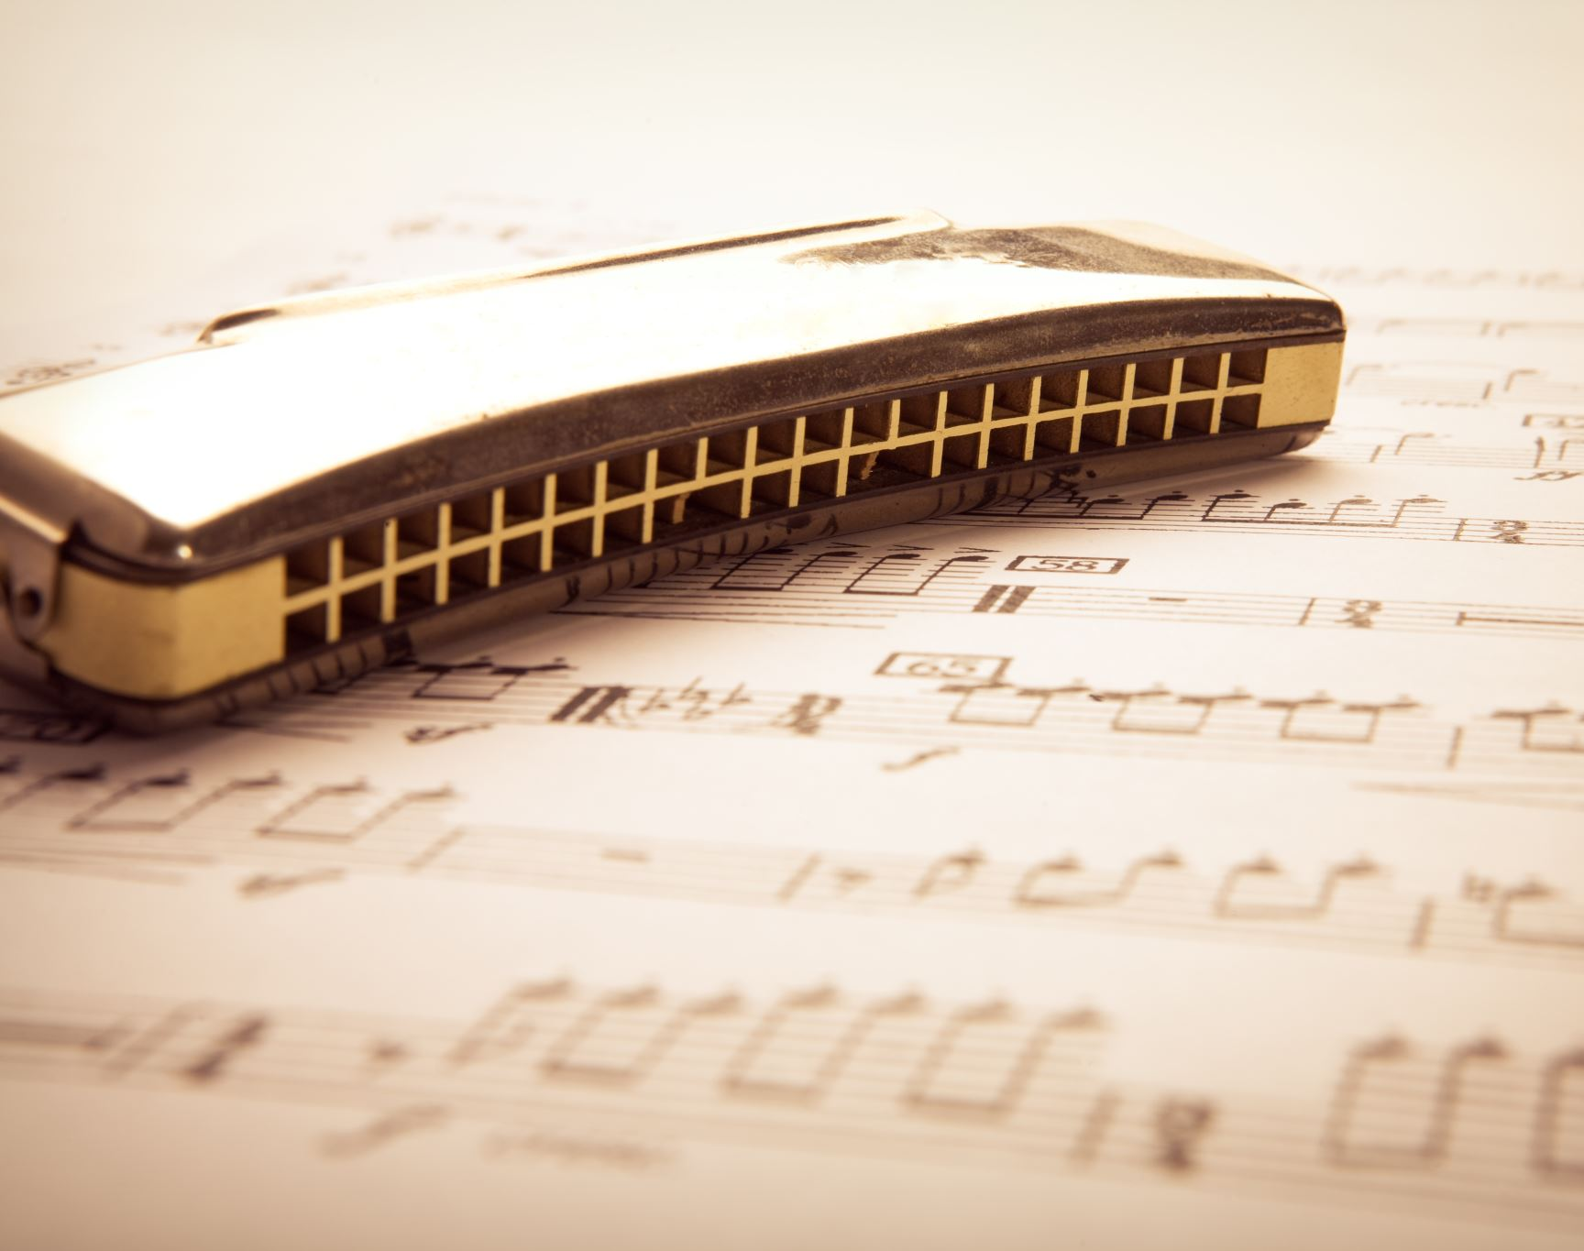
Musify- Music Composition using A.I.
By Madhav Gupta

Slide 2

Music Composition
Music composition is process where music notes are put together creating a new piece of music that gives pleasant sensation to our ears.
Parameters such as pitch interval, notes, chords, tempo etc. are used for composing short piece of music.

Slide 3
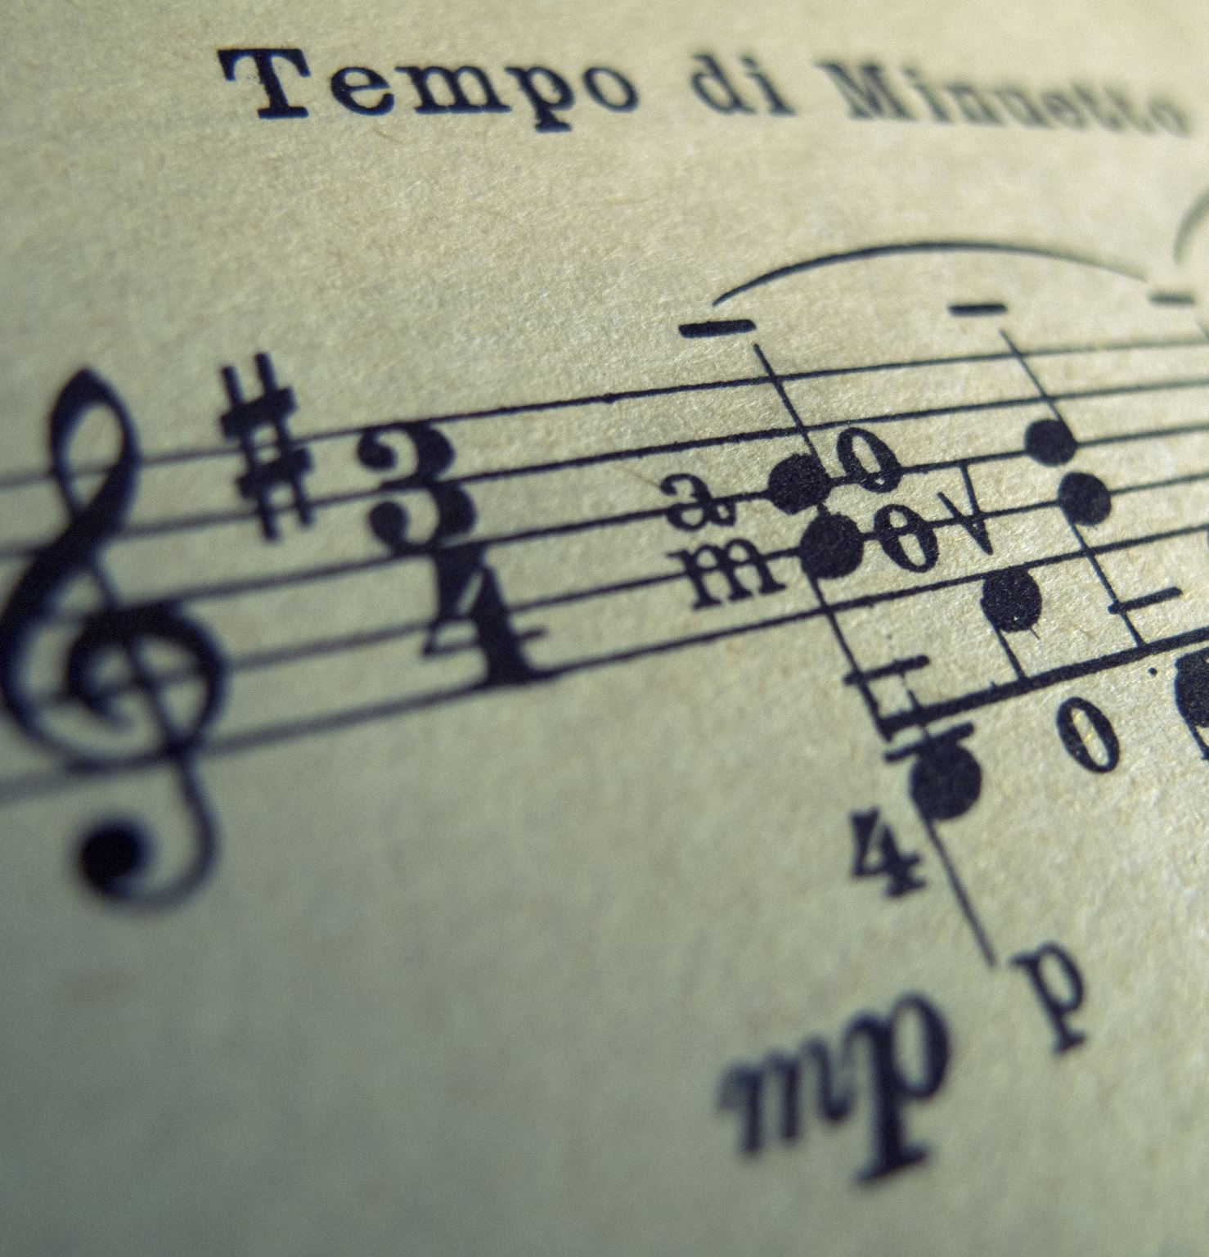
Details of the Project
Project focuses on music generation model
About training model through sample notes of Piano & make it produce new music.
Uses LSTM(Long-Short Term Memory), a type of Recurrent Neural Network (RNN).
Platform: Google Colab, Jupyter Notebook
Programming Language: Python 3.8
Libraries Used: TensorFlow, Music21, Keras, NumPy, Sklearn, tqdm
Dataset: Classical Music MIDI | Kaggle

Slide 4
Terminologies
Note: This is a sound produced by a single key.
Chords: The combination of 2 or more notes is called a chord.
Octave: The distance between two notes is stated as an octave.
Recurrent Neural Networks (RNN): A recurrent neural network is a class of artificial neural networks that make use of sequential information.
Long-Short Term Memory (LSTM):
LSTMs are a type of Recurrent Neural Network that can efficiently learn via gradient descent
Using a gating mechanism, they are able to recognize and encode long-term patterns.
Useful to solve problems where the network has to remember information for a long period of time.
Applications: Music and text generation etc.

Slide 5
Libraries
Music21:
Music21 is a Python toolkit used for computer-aided musicology
It allows us to teach the fundamentals of music theory, generate music examples and study music.
Keras:
Keras is a high-level neural networks API that simplifies interactions with TensorFlow.
TensorFlow:
TensorFlow is a free and open-source software library for machine learning and artificial intelligence.
It can be used across a range of tasks but has a particular focus on training and inference of deep neural networks.
NumPy:
NumPy is a Python library used for working with arrays.
tqdm:
tqdm is a library in Python which is used for creating Progress Meters or Progress Bars.

Slide 6

Project Structure
All Midi Files/ : This is the dataset folder containing various midi files of different composers.
Code.ipynb : In this file, we will build, train and test our model.
MOD/ : This directory contains optimizer, metrics, and weights of our trained model.
AI_composed_music.mid: This is a music file of predicted notes.

Slide 7

Steps for Developing the code
Step 1: Import Libraries
Import all the important Libraries.
Step 2:Reading and Parsing the Midi File
The midi file dataset has to be read using Music21 library
“grieg” composed files has been used.
For this project, the files that contain sequential streams of Piano data has only been worked on.
Piano stream from the midi file contains many data like Keys, Time Signature, Chord, Note etc. We require only Notes and Chords to generate music.
The arrays of notes and chords has to be returned

Slide 8

STEP 3: Exploring the Dataset
This is done to check the number of unique notes and their distribution
50 is used as a threshold frequency . Only those notes which have frequencies more than 50 have been considered.
Input and output sequences for our model are created
STEP 4: Input & Output Sequence for Model
A timestep of 50 has been used. So, if we traverse 50 notes of our input sequence then the 51st note will be the output for that sequence
Step 5: Training & Testing Sets
Array for our model is re-shaped and the data is split into 80:20 ratio.

Slide 9

Step 6 Building the Model
2 stacked LSTM layers with a dropout rate of 0.2 are used .
A fully connected Dense layer has been used for output.
Step 7 Training the Model
After building the model , it is trained on the input and output data.
For this 'Adam Optimizer ' is used on batch size of 128 and a total of 30 epochs.
After Training, model is saved for prediction.
Step 8 Inference Phase
Using the trained model, the notes will be predicted
The predicted output notes are saved in a MIDI file.
Step 9 Saving the File

Slide 10
THANK YOU

